Slide 1
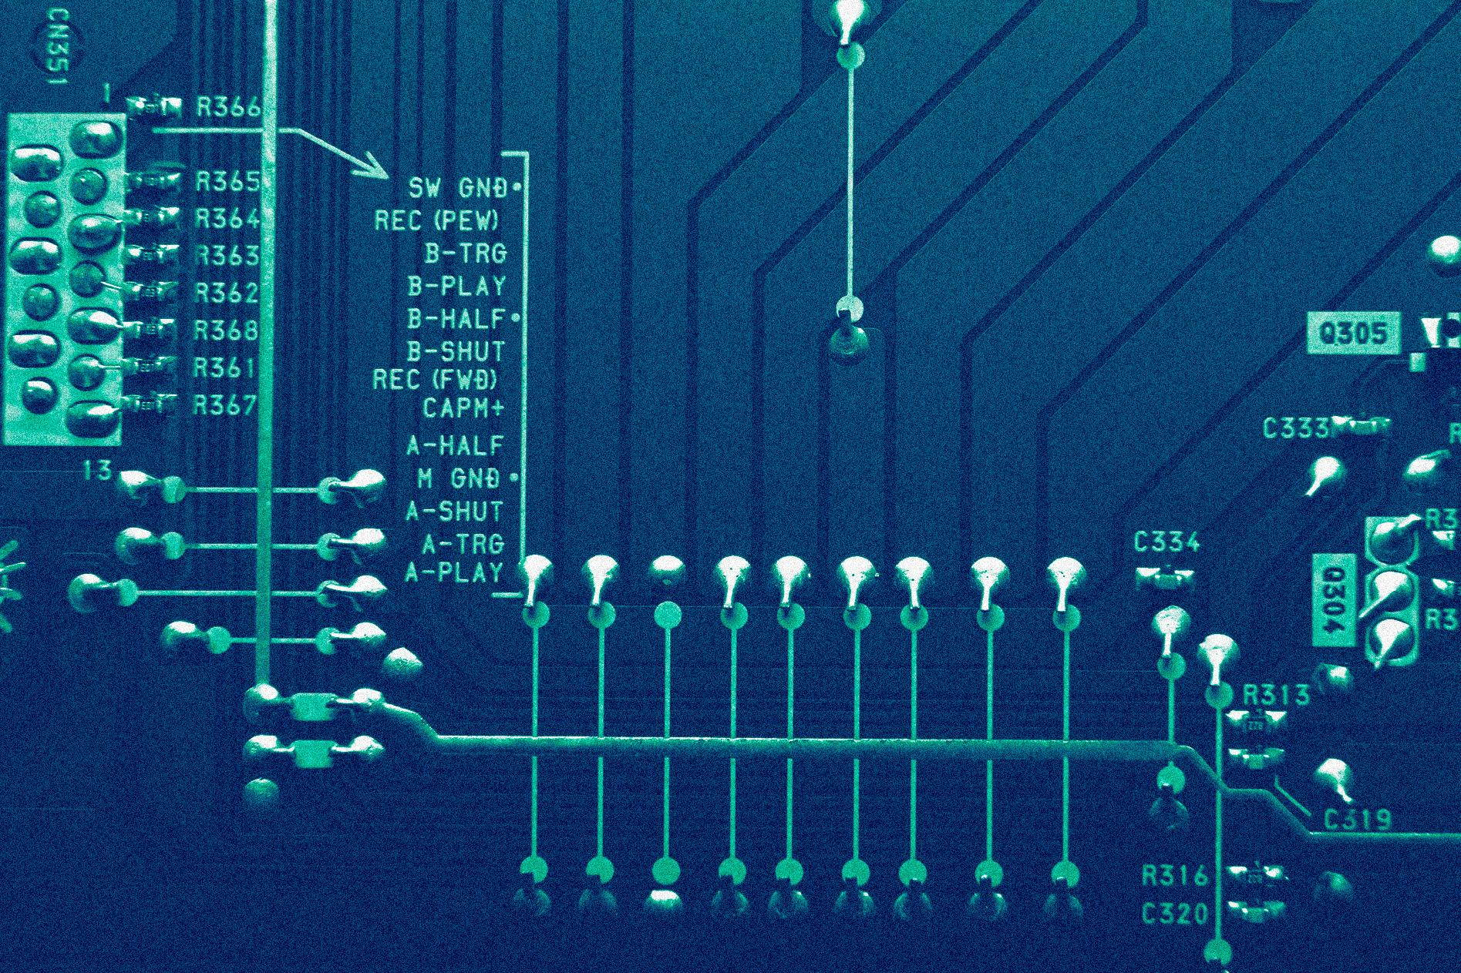
EEE- 202
Automatic Fire Fighting Robot
ARDUINO UNO

Slide 2
Group Members
KHONDOKAR SAIM
MD.FAHAD NAKIB
MD.SHIHABUR RAHMAN
221902353
221902149
221902154
HASNAT ZAMIL
MD.NAFIJUL ISLAM
MD.SUMON MIA
221902001
221902156
221902155

Slide 3
Table of contents
01
02
03
04
Introduction to Fire Fighting Robots
Role of Arduino in Fire Fighting Robots
List of equipment used in this project and their details
Design and Construction of the Fire-Fighting Robot
05
Sensing and Detection Systems in Fire Fighting Robots
06
Challenges and Future Directions

Slide 4
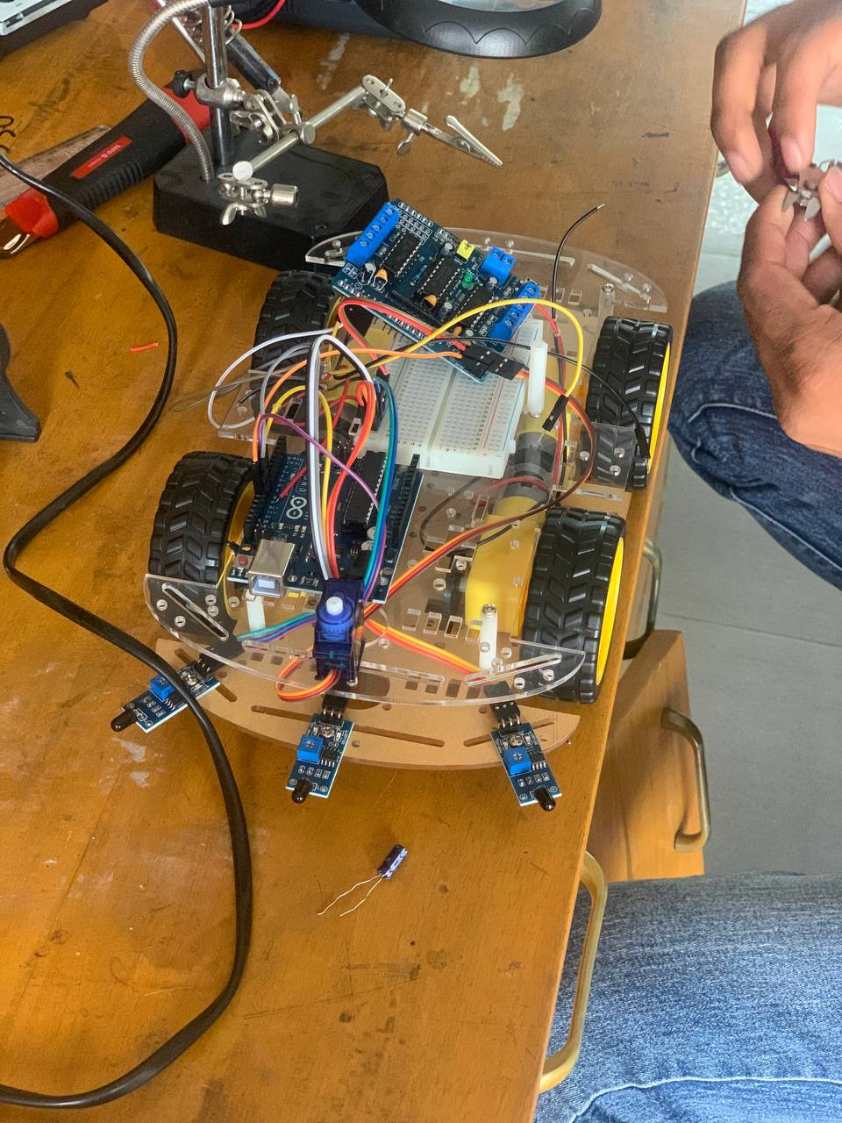
Theory design
Introduction to Fire Fighting Robots
Purpose of Fire Fighting Robots:
Benefits of Fire Fighting Robots:
Assist in extinguishing fires and performing firefighting tasks in hazardous and inaccessible environments.
Minimize the risk to human firefighters by operating in dangerous conditions, such as burning buildings or industrial incidents.
Enhance response times and effectiveness in firefighting operations.
Increased safety
Improved efficiency
Continuous operation
Real-time monitoring
Remote operation

Slide 5
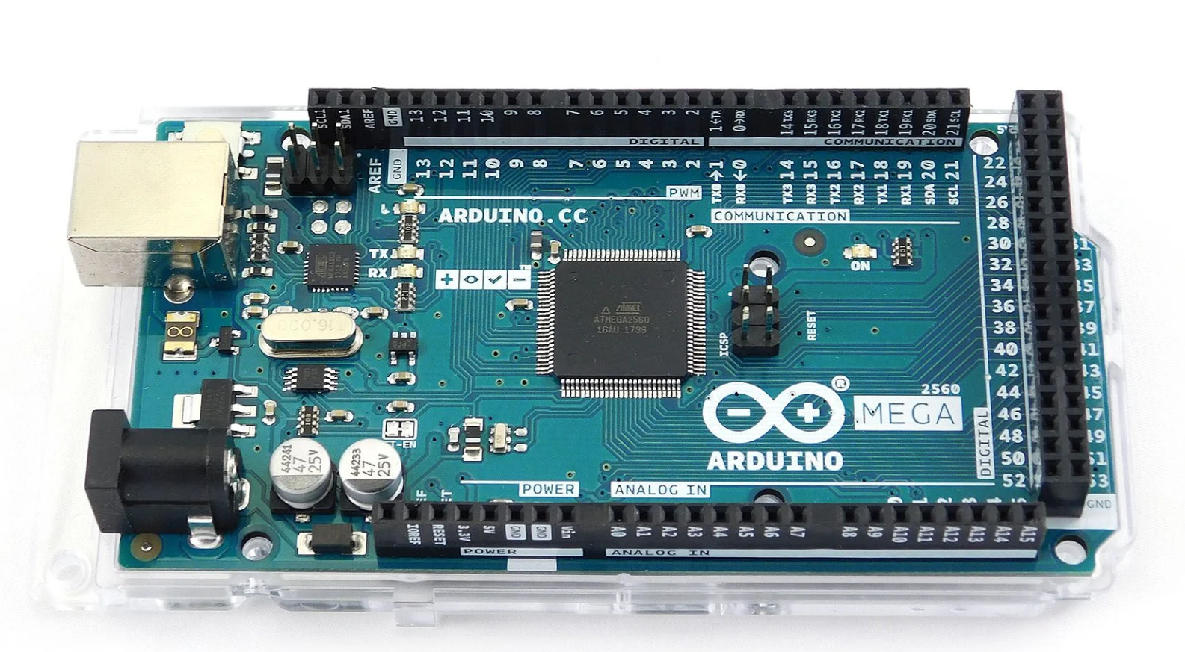
Theory & design
Role of Arduino in Fire Fighting Robots
Arduino serves as a microcontroller platform that enables the development of the robot's control system.
It provides a flexible and programmable interface to connect and control various components, such as sensors, actuators, and communication modules.
Arduino allows for the integration of advanced algorithms and logic to enhance the robot's autonomy and firefighting capabilities.
It enables the development of a user-friendly interface for controlling the robot, making it easier for firefighters to operate and monitor.

Slide 6
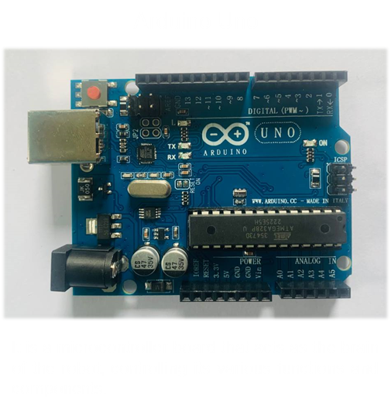
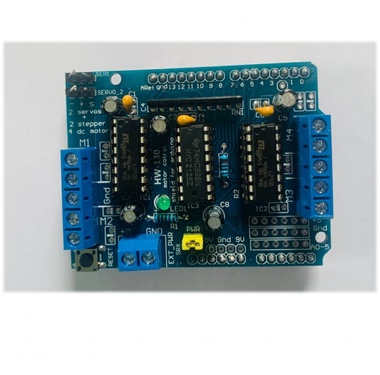
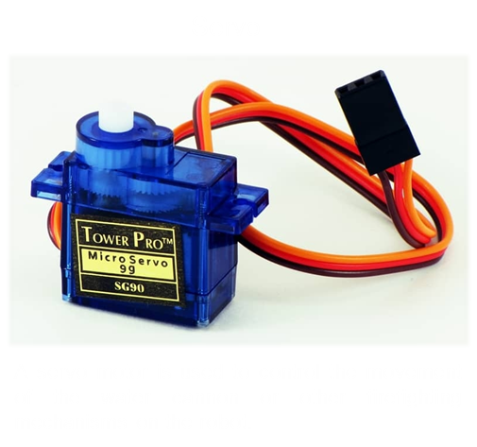
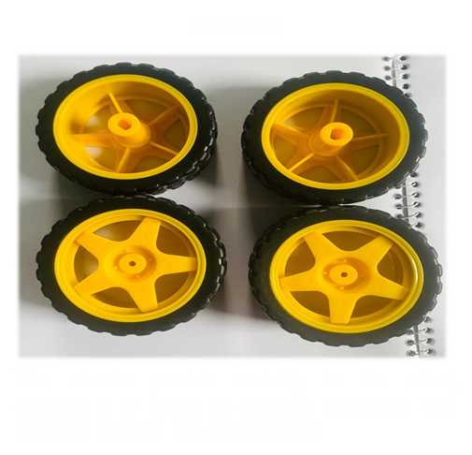
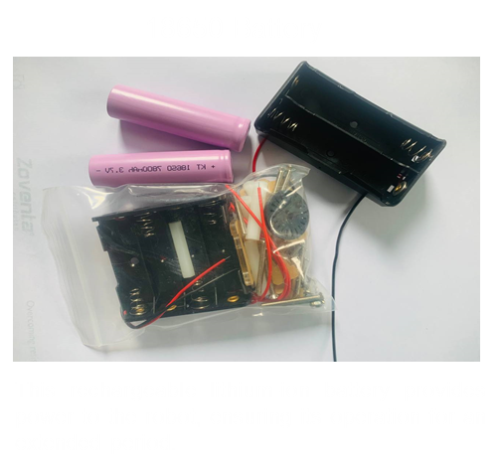
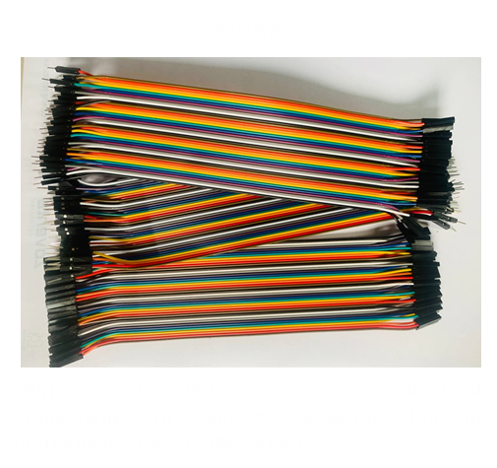
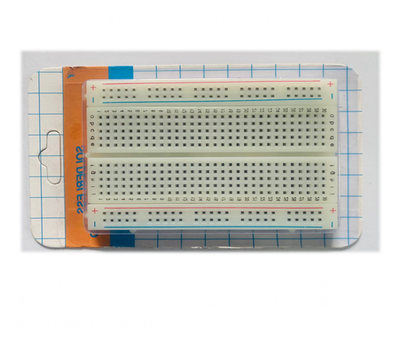
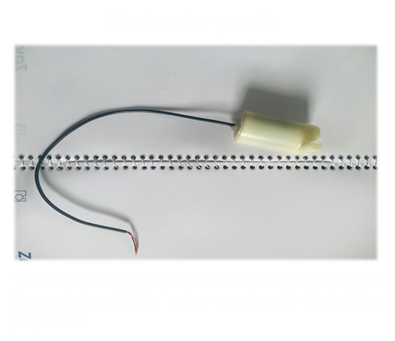
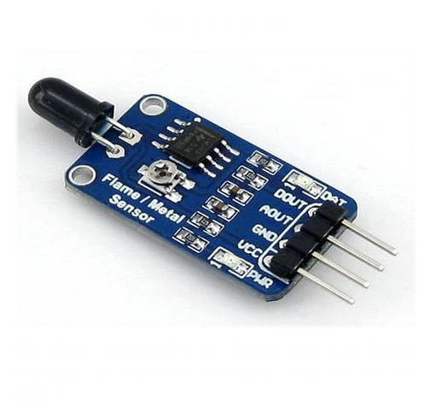
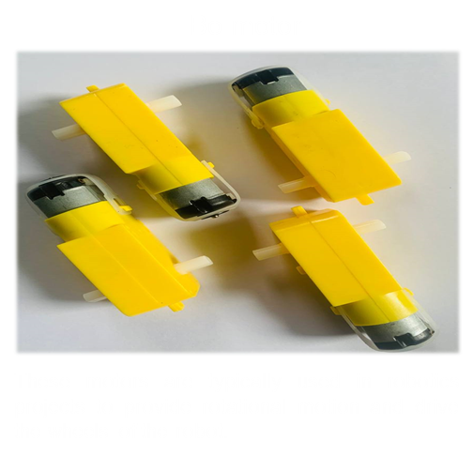
Theory & design
List of equipment used in this project and their details
Equipment List :
Arduino Uno
L293 motor driver
Flame sensor
Bo motor
Wheels
Servo
18650 Battery
Jumpers
Mini water pumb
Mini breadboard
Container
Waterline

Slide 7
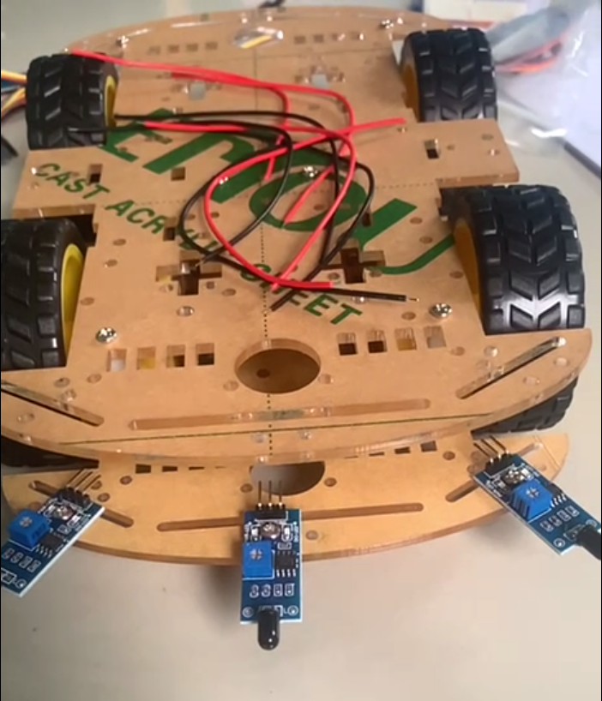
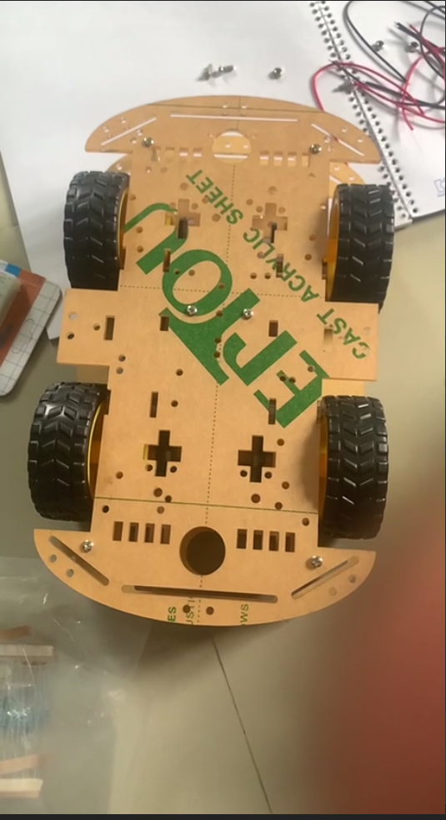
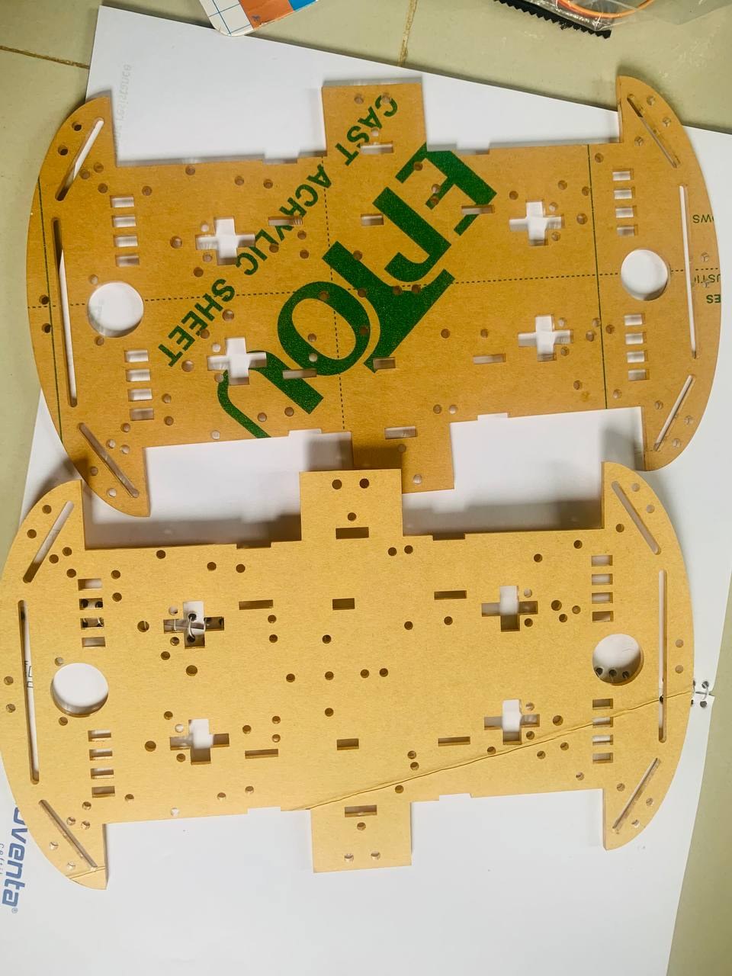
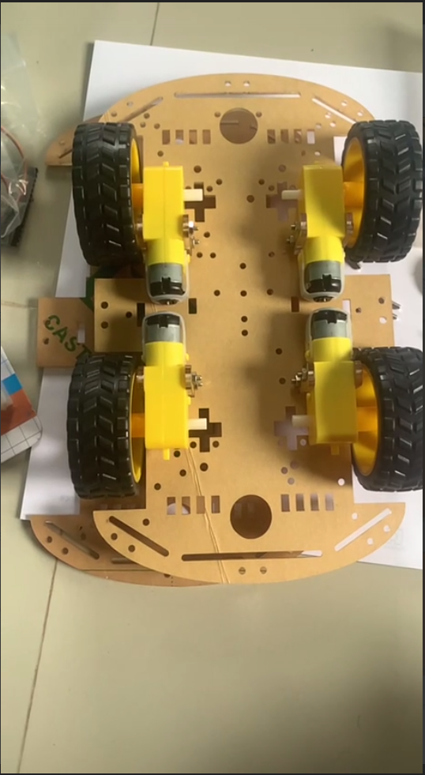
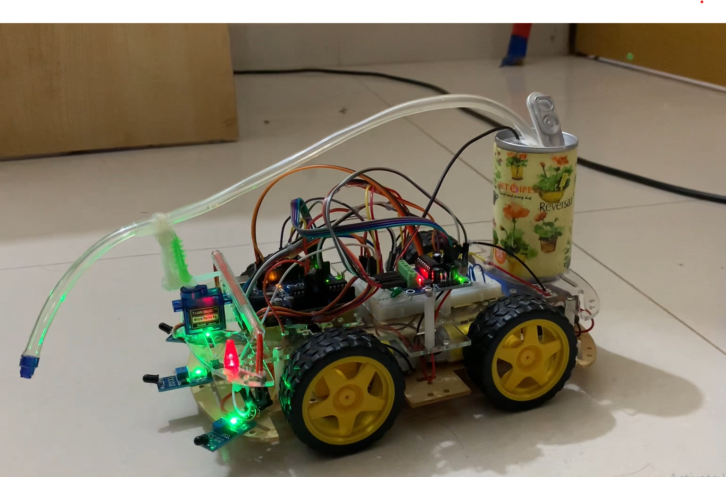
Theory & design
Design and Construction of the Fire-Fighting Robot
Construction of this project :

Slide 8
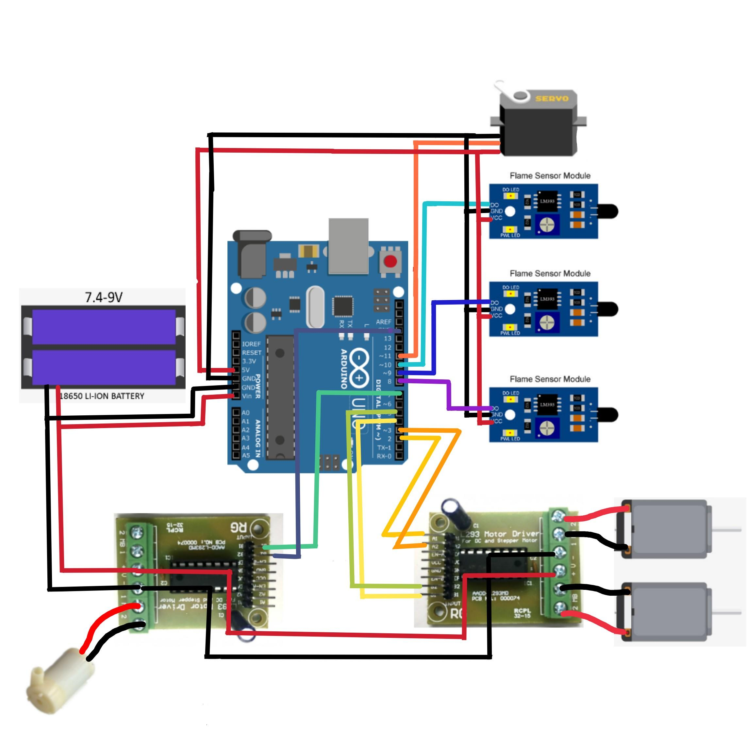
Theory & design
Design and Construction of the Fire-Fighting Robot
Circuit Design of this project :

Slide 9
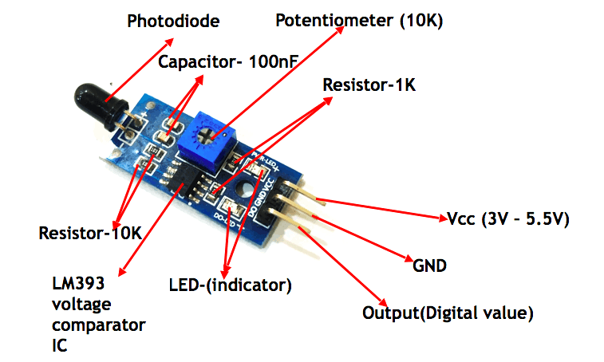
Theory & design
Sensing and Detection Systems in Fire Fighting Robots
FLAME SENSOR
what is flame sensor?
The flame sensor is a key component used in the fire-fighting robot to detect the presence of fire and smoke.
How it works?
It works by detecting the infrared radiation emitted by flames, allowing the robot to identify the location of the fire source.

Slide 10
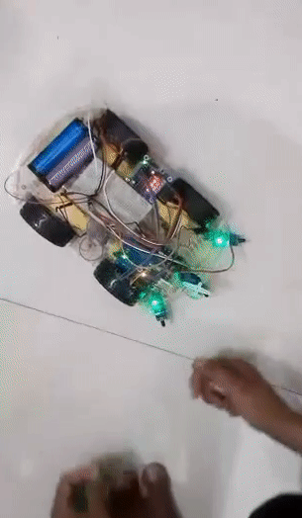
Theory & design
Sensing and Detection Systems in Fire Fighting Robots
FLAME SENSOR
Automatic firefighting capabilities:
The robot is given the ability to automatically detect and react to fire occurrences by adding a flame sensor.
The robot's firefighting systems are activated when the flame sensor detects the presence of fire or smoke.
The robot can activate its water pump to suppress the fire at the detected location.

Slide 11

Theory & design
Challenges and Future Directions
Challenges faced during development:
Ensuring accurate fire detection and reliable operation of the flame and smoke sensors in different environments.
Balancing the weight and size of the robot to maintain agility while carrying firefighting equipment and power sources.
Ensuring the safety of the robot and firefighters during operation, including fireproofing measures and fail-safe mechanisms.

Slide 12
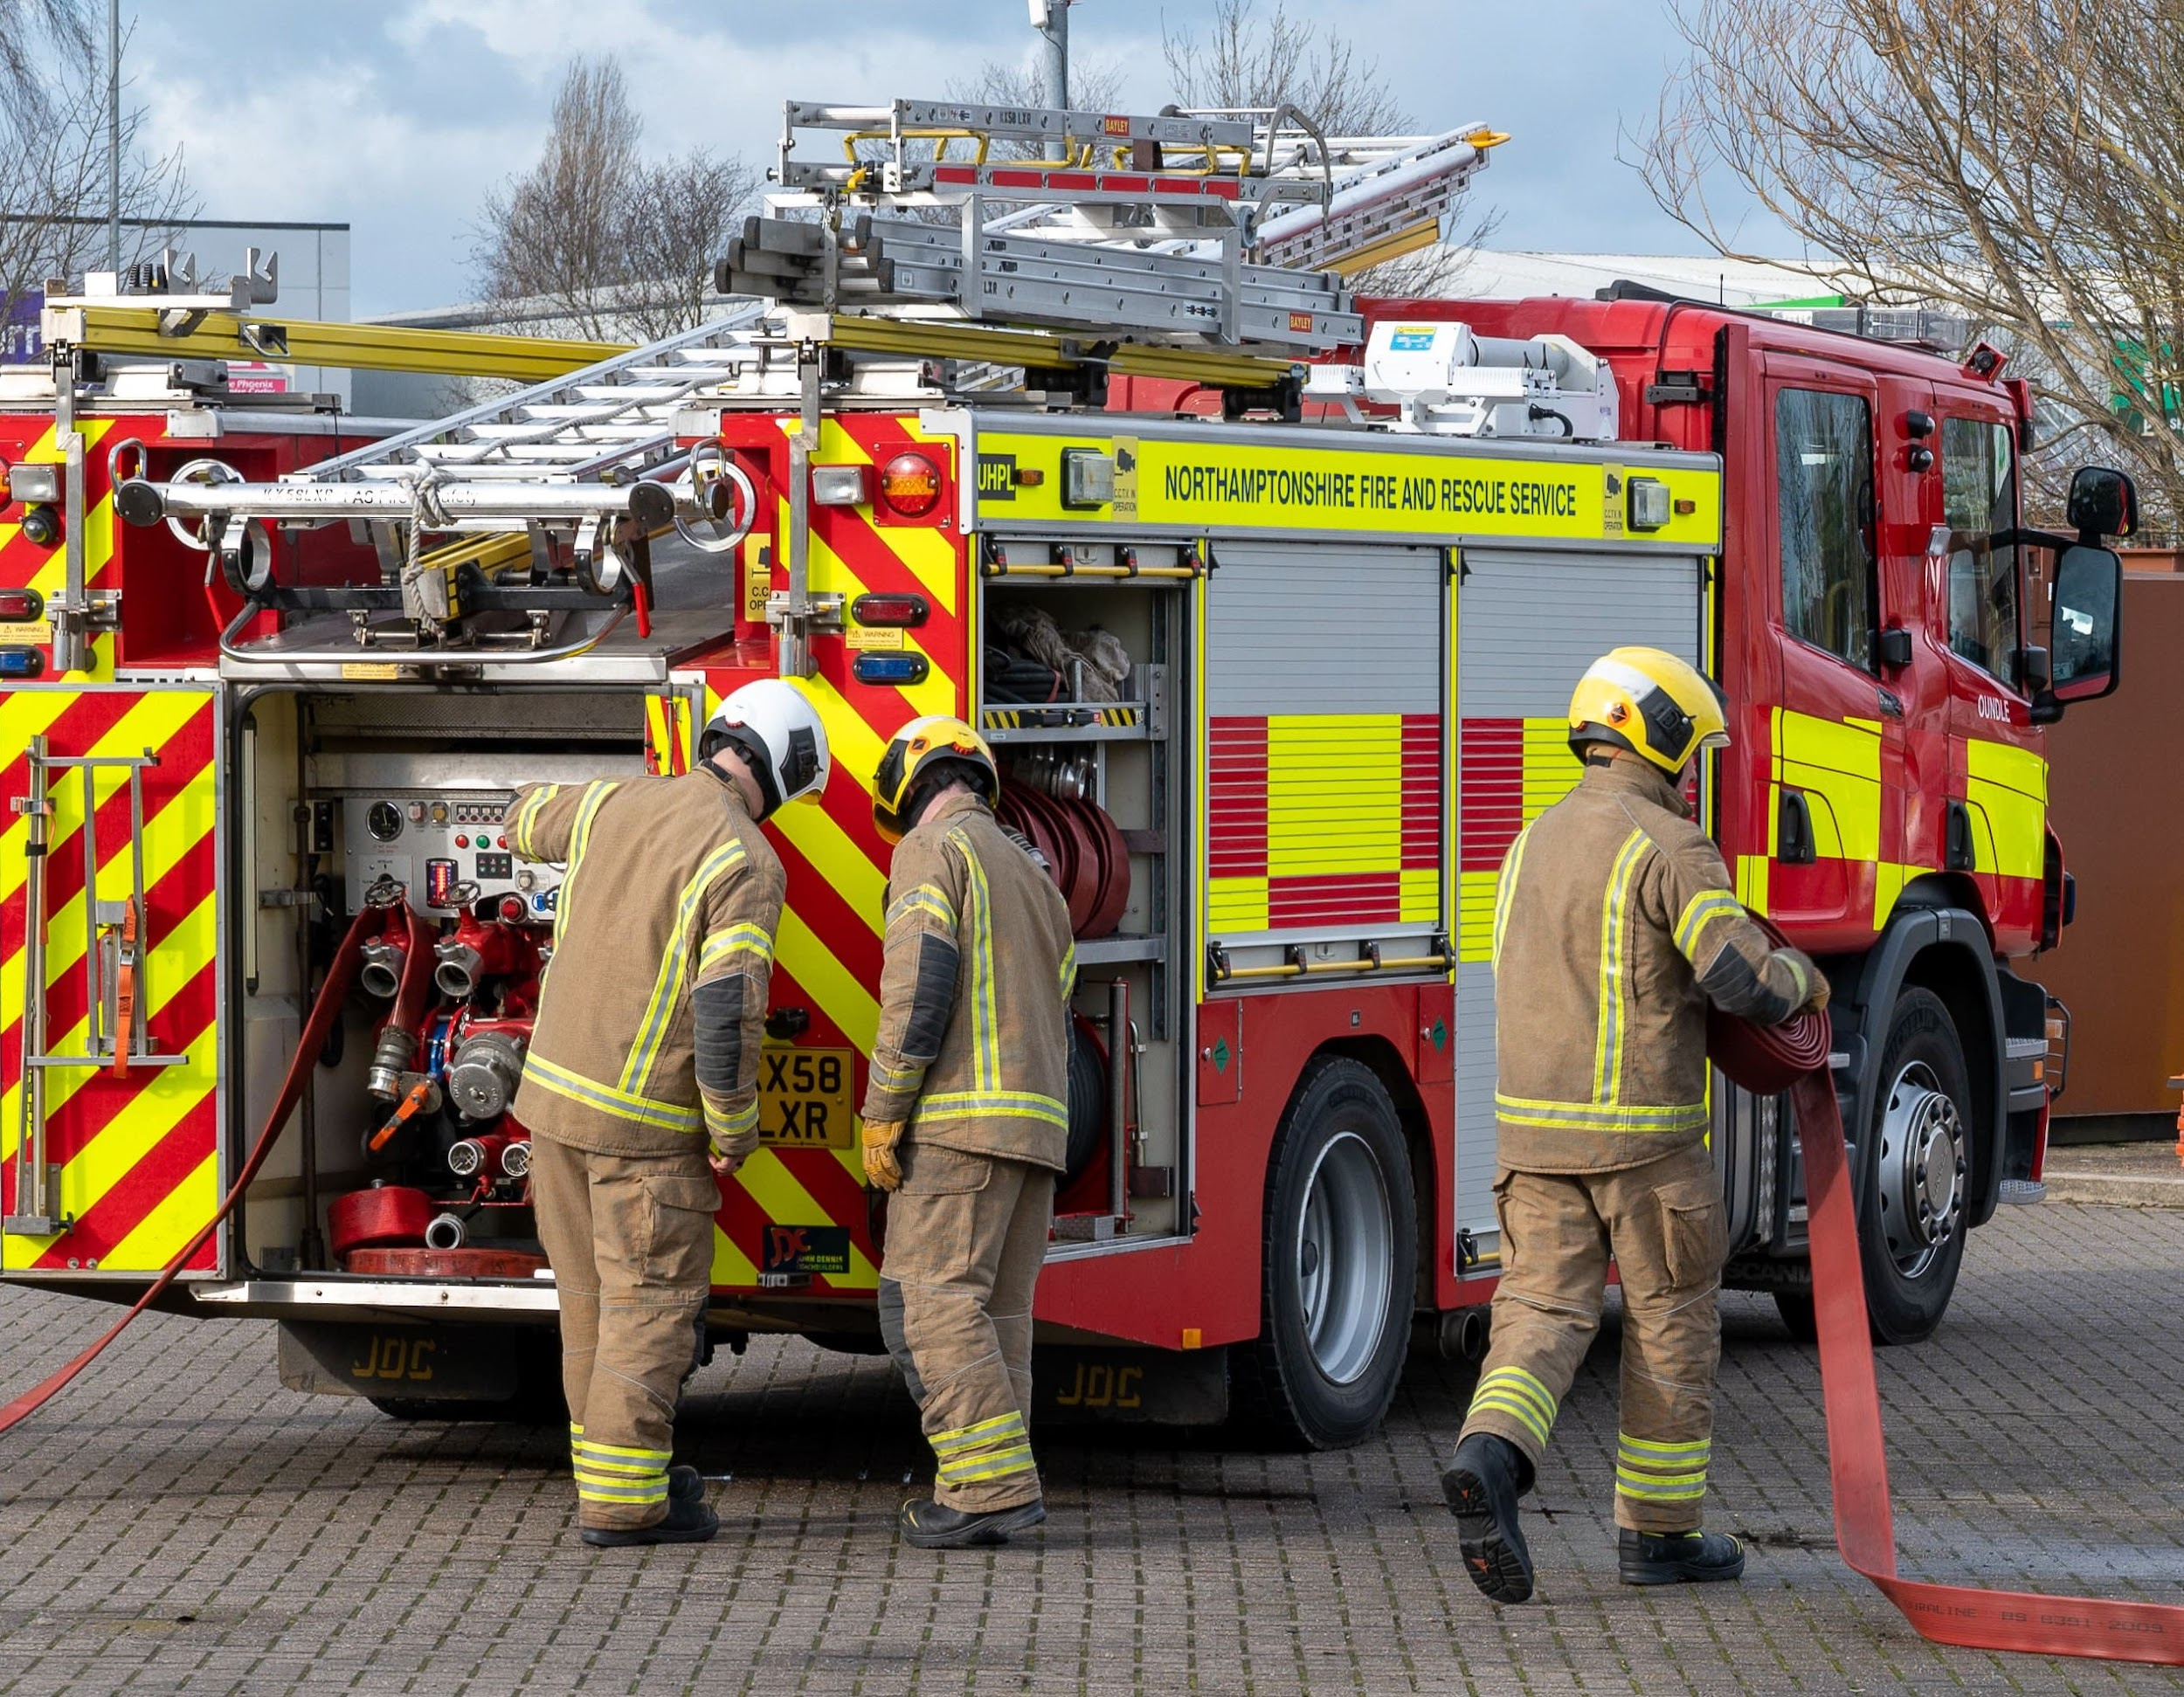
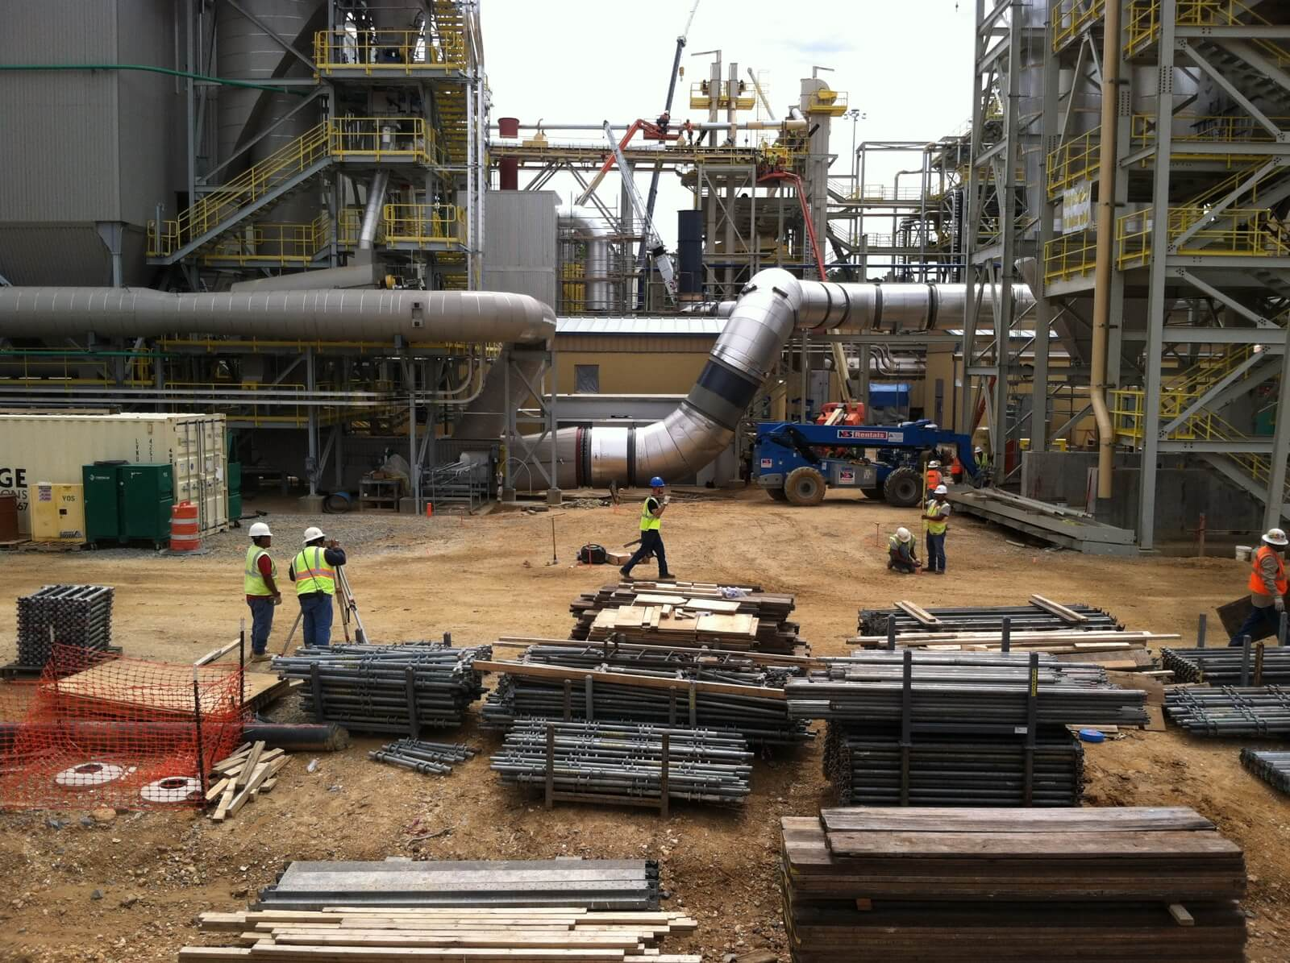
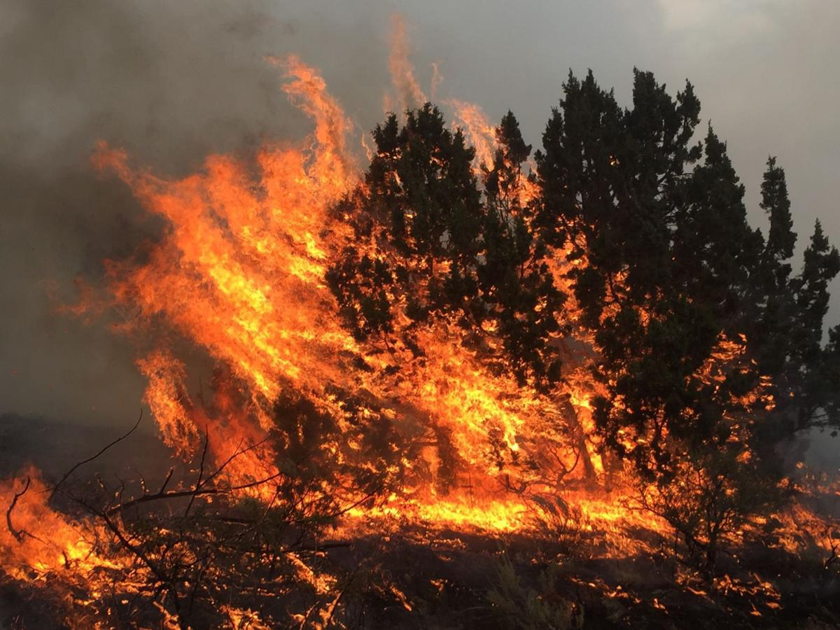

Theory & design
Challenges and Future Directions
Future applications of fire-fighting robots:
Industrial settings
Urban firefighting
Disaster response
Remote and hazardous environments

Slide 13

Thanks!
Do you have any questions?
addyouremail@freepik.com
+91 620 421 838
yourwebsite.com

